Slide 1
Funding Your Education Beyond High School
2021-2022
Excerpts and Graphics Provided by:
National Association of Student Financial Aid Administrators
North Dakota Association of Student Financial Aid Administrators

Slide 2
Tonight’s Agenda
Definition of Financial Aid
1
Description of Financial Aid Programs
2
Creating for FSA ID
3
Completing the FAFSA
4

Slide 3
Financing Your Education
What is Financial Aid?
FAFSA Process
Where does it come from?
What aid is available?
Create FSA ID
Complete FAFSA

Slide 4
What is Financial Aid
College or Outside Agencies
Scholarships
Federal or State
Grants
Subsidized or Unsubsidized
Loans
Institutional or Federal
Employment

Slide 5
Definition of Need
Cost of Attendance (COA)
Estimated Family Contribution (EFC)
Financial Need

Slide 6
Cost of Attendance
Tuition & Fees
Room & Board
Books & Supplies
Personal Expenses
Notes:
Direct Costs (Tuition/fees and Room/Board possibly books)
Indirect Costs (Possibly books and Personal)

Slide 7
Need Varies Based on Cost
$20,000
$18,766
1
$15,000
X
$13,766
2
$10,000
Y
$8,766
3
$1,234
Z
EFC
Cost of
Expected Family
Need
Attendance
Contribution
(V
ariable)
(V
ariable)
(Constant)

Slide 8
Financing Your Education
What is Financial Aid?
Steps in Financial Aid Process
Where does it come from?
What aid is available?
Apply for FSA ID
How do I apply?

Slide 9

FAFSA Process
The student (and parents) complete the Free Application for Federal Student Aid (FAFSA)
The student will receive a Student Aid Report (SAR). The school will receive the same information. Student may be selected for “verification.”
FAFSA data is received by U.S. Department of Education Central Processing Service (CPS). The CPS calculates an Expected Family Contribution (EFC).
Send a paper FAFSA or submit an electronic FAFSA online or use myStudentAid App

Slide 10
And then. . .
Step 1
Student will receive notification that his/her award is available to accept/decline online
Step 2
Student reviews information online for each award offered
Student accepts/declines awards
Step 3
Student completes any additional paperwork required for their awards

Slide 11
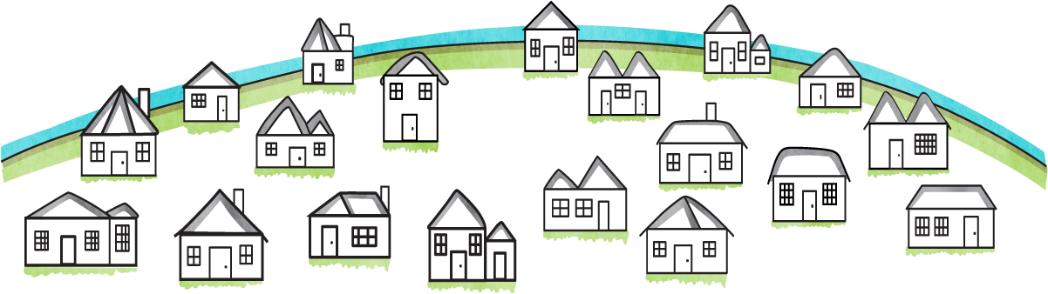
Special Circumstance
Unusual uncovered medical/dental expenses
Foreclosure/Liquidation
Contact The
Financial Aid Office
Loss of employment
Divorce
Parent or spouse death
Documentation:
Paid receipts
Tax returns
Divorce decree

Slide 12
Financing Your Education
What is Financial Aid?
Steps in Financial Aid Process
Where does it come from?
What aid is available?
Apply for FSA ID
Complete the FAFSA

Slide 13

Sources of Financial Aid
State
Grant
Scholarships
Federal
  Pell Grant
  FSEOG Grant*
  Work-Study*
  Direct Loans
  Direct PLUS Loans
Private/Local/Institutional
  Loans
  Scholarships*
* Colleges have a limited amount of these funds.

Slide 14
Federal Pell Grant
Portable
Actual award amount based on COA, EFC, & full- or part-time
Maximum award for 2020-2021 = $6,345
Maximum of 12 terms or 600% of cumulative eligibility

Slide 15
Federal Supplemental Educational Opportunity Grant (FSEOG)
Awarded first to students with exceptional financial need (i.e., students with lowest EFC’s at that school)
Annual Award Amounts
$100 minimum
Eligible Students
$4,000 maximum

Slide 16
Federal Workstudy
Employment may be on- or off- campus
Students may receive paycheck or put towards tuition/housing costs

Slide 17
Federal Direct Loans
Subsidized (interest is paid by the government while in school): Must demonstrate “need”
Unsubsidized (interest can be paid by the student or can accrue): Need is not considered
Base annual loan limits (combined subsidized & unsubsidized):
$5,500 for 1st year undergraduates
$6,500 for 2nd year undergraduates
$7,500 for each remaining undergraduate year
$8,500 for each year graduate/professional (Unsubsidized Only)
Additional unsubsidized loan eligibility for independent undergraduate, graduate, & dependent students whose parents are unable to borrow PLUS:
$4,000 per year for first & second years of undergraduate study
$5,000 per year for remaining years of undergraduate study
$12,000 per year for graduate & professional students
Notes:
SULA (Subsidized Usage Loan Aggregate) 150% of required time to complete program. Example 2 year Associate Degree – eligible for Subsidized Direct Loan for 2.5 years.

Slide 18
Federal Direct Loan Repayment
6-month grace period after the student leaves college
Maximum repayment period between 10 & 30 years depending on repayment plan chosen
Deferment & cancellation provisions available
Interest rate for 2020-2021 was 2.75% (subject to change each
July 1st)

Slide 19

South Dakota
Scholarship Programs
Build Dakota Scholarship
Critical Teaching Needs Scholarship
Dakota Corps Scholarship
Davis-Bahcall Scholarship
Hagen-Harvey Scholarship
SD Opportunity Scholarship
http://doe.sd.gov/scholarships/

Slide 20
North Dakota State Programs
State Grant
Need based award ranges from $275 to $2,200
Scholars Program
Must be in the upper 5% of all ND ACT test takers
Only applicable towards ND Colleges
ND resident & citizen or permanent resident of U.S.
Pro-rated for enrollment status
Take ACT between October and June of Junior Year
Full Tuition Scholarship - Renewable for up to 3 years by maintaining 3.5 GPA
Only applicable toward ND Colleges
Must be ND Resident
ND High School Graduate
www.ndus.edu/students
www.dpi.state.nd.us
Academic Scholarship
Only applicable to ND Colleges
Must maintain College 2.75 GPA
Have 3.0 High School GPA
Complete Application on ND Dept of Public Instruction Website (March 5th through June 12th)
$750 per semester
Career & Technical Education Scholarship
Only applicable to ND Colleges
$750 per semester
Must maintain College 2.75 GPA
Have 3.0 High School GPA
Complete Application on ND Dept of Public Instruction Website (March 5th through June 12th)

Slide 21

New ND Program
The 2019 Legislative Assembly created two new skilled workforce programs designed to recruit individuals into “high need and emerging occupations” in the state.
  This is a program to fill and grow ND’s workforce needs.
Two components – Individuals may qualify for only one program, not both.
  1. Scholarship
  2. Loan Repayment
  https://ndus.edu/career-builders/

Slide 22
Minnesota State Grant
Minnesota residents attending a Minnesota college/university as a full-time student (15 credits per term)
FAFSA must be processed within 30 days of the term start date
Maximum award for 18-19 was $7,845 at public and tech colleges ($12,345 at private colleges). The average award is $2,603
https://www.ohe.state.mn.us/

Slide 23
Additional Sources of financial assistance
Veteran’s Benefits
Bureau of Indian Affairs
Vocational Rehabilitation
WIA – Job Service
Health Professionals/Nursing - www.bhpr.hrsa.gov/dsa
Notes:
Veteran’s Benefits – National Guard Tuition Reimbursement Program & Loan Repayment Program
Bureau of Indian Affairs – Any type of Indian Blood, contact tribe for details
Vocational Rehabilitation – IEP

Slide 24
Private Scholarship Searches
Free Internet Scholarship Search Engines
FinAid.org
http://www.finaid.org
The College Board
http://www.collegeboard.com
FastWeb.com
http://www.finaidwww.fastweb.com.org
www.srnexpress.com
Scholarship Resource Network Express
GoCollege.com
The Collegiate Websource – http://www.gocollege.com

Slide 25
Alternative Loans
Bank of ND DEAL Loan
www.campusdoor.com/BND/DEAL/
SallieMae Loan
Minnesota SELF Loan
www.mheso.state.mn.us/self/self.cfm
Federal Direct PLUS Parent Loan
www.studentaid.gov
www.salliemae.com

Slide 26
Tax Benefits for College Costs
Tax Incentives (www.irs.gov) Publication 970:
  Lifetime Learning Credit – families can claim $2,000 per year in tax credits for tuition expenses. No limit on number of years to be claimed.
  Deduction for Student Loan Interest -You can deduct up to $2,500 in student loan interest. The deduction is taken as an adjustment to income.
  Coverdell Education Savings Account – taxpayers can contribute $2,000 per year for each student under age 18.
  529 Savings Plans – College SAVE plan – No Limit to
  contribution.

Slide 27
Financing Your Education
What is Financial Aid?
Steps in Financial Aid Process
Where does it come from?
What aid is available?
Apply for FSA ID
Complete the FAFSA

Slide 28
Creating FSA ID
  The student and at least one parent need to have an FSA ID created before completing the FAFA
  Your FSA ID is used as your signature on documents for the Department of Education

Slide 29
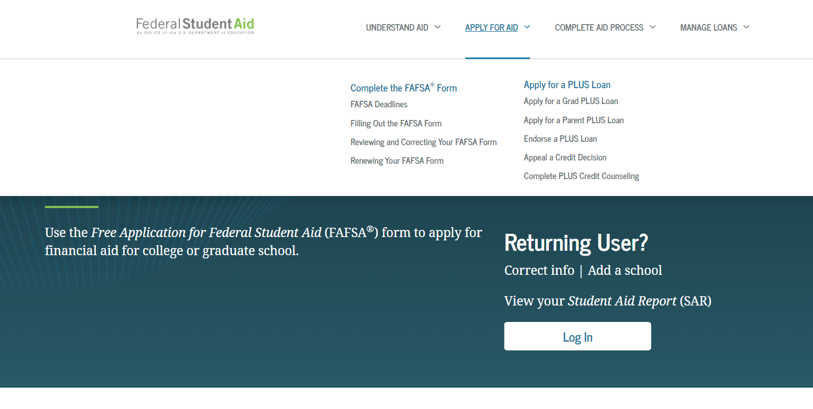
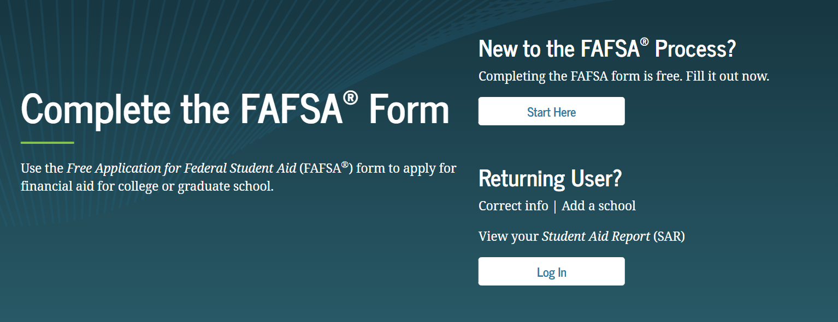
Completing the FAFSA www.studentaid.gov
1.
2.
Log in as the student to make the signature process the easiest.

